Slide 1
TOMBSTONE CLIENTS IN SOUTH-WESTERN PANNONIA:
SOCIAL AND ECONOMIC ASPECTS
Branka Migotti
The Croatian Academy of Sciences and Arts
Zagreb

Slide 2
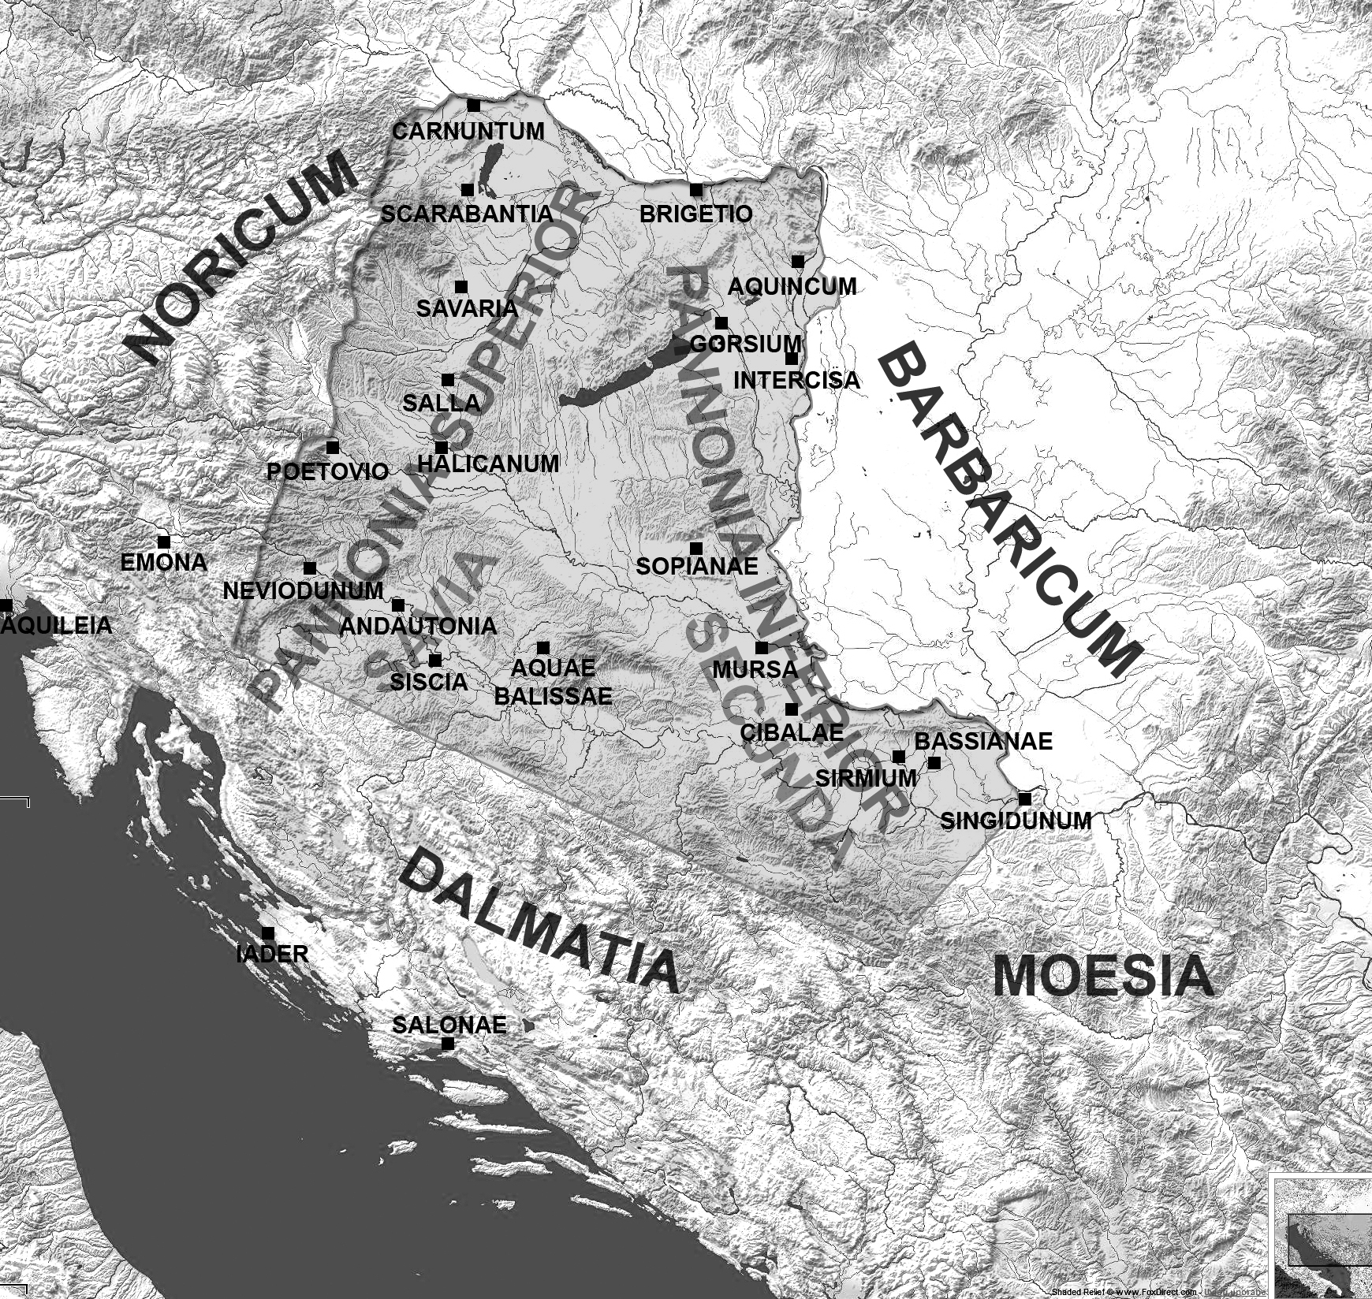
FUNERARY STONES OF SW PANNONIA IN THEIR MATERIAL, SOCIAL AND RELIGIOUS CONTEXT
TOMBSTONE CLIENTS IN SW PANNONIA: SOCIAL AND ECONOMIC ASPECTS

Slide 3
TOMBSTONE CLIENTS IN SOUTH-WESTERN PANNONIA:
SOCIAL AND ECONOMIC ASPECTS
I. SOCIAL BACKGROUND OF THE PURCHASERS
- CIVILIANS VS. MILITARY, ACTIVE SOLDIERS OR VETERANS,
ROMAN CITIZENS VS. PEREGRINI AND SLAVES)
II. SOCIO-ECONOMIC ASPECTS
- KIND OF MONUMENT (TITULUS, STELE, SARCOPHAGUS, ALTAR, AEDICULA)
- MATERIAL USED (MARBLE OR OTHER STONE, LOCAL OR IMPORTED)
- QUALITY OF EXECUTION
III. RELATIONSHIP BETWEEN THE COMMEMORATORS AND COMMEMORATED

Slide 4
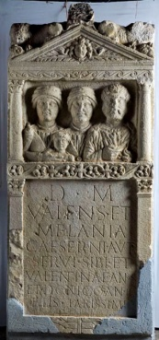
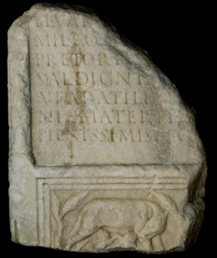
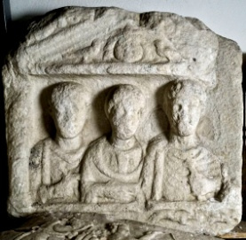
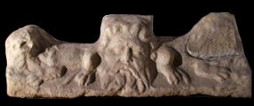
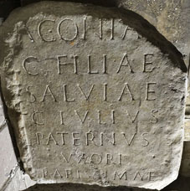
107 MONUMENTS – 3 GROUPS
EPITAPH AND PICTURE : 23
15 portraits 8 accessory picture
46
ONLY PICTURE : 34
13/11 portrait 21 accessory picture
3. ONLY EPITAPH: 33/18

Slide 5
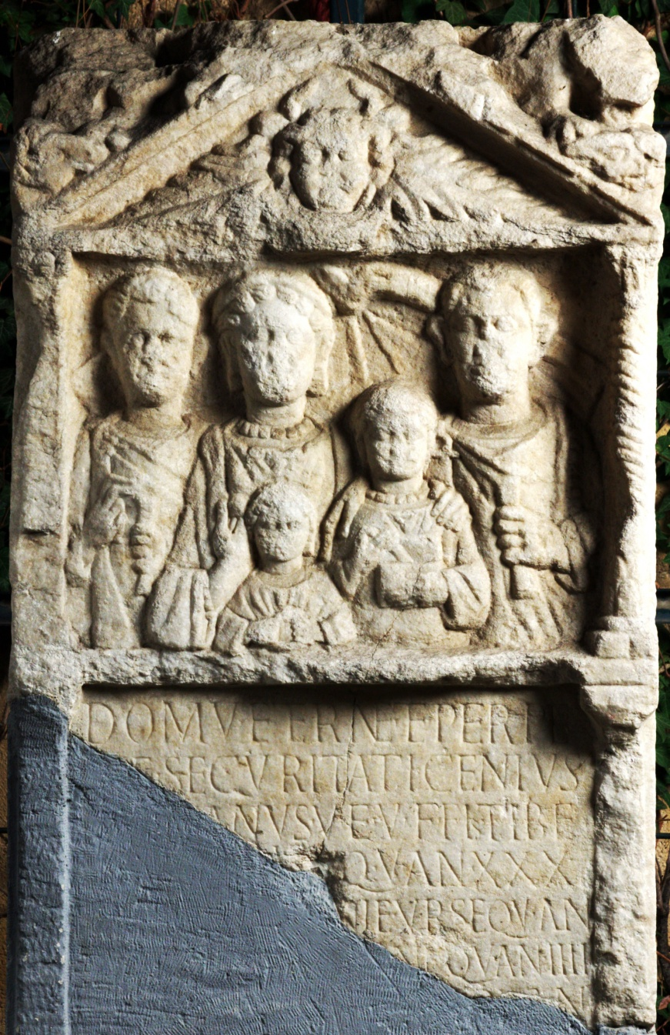
THE STELE OF C(A)ENIUS
Sisak, 2nd half of the 3rd c., Archaeological Museum in Zagreb
Domu (!) aetern(a)e et perpe-
[t]u(a)e securitati C(a)enius
[---]ianus v(ir) e(gregius) v(ivus) f(ecit) Fl(avio) Tibe-
[rian]i[co?] q(ui) v(ixit) an(nos) XXX-
⁵ [---]ni (a)e Urs(a)e q(uae) v(ixit) an(nos)-
[---]ne q(uae) v(ixit) an(nos) IIII
[---] q(uae) v(ixit) an(nos)
[------
To the eternal home and lasting security.
C(a)enius (? ianus), vir egregius, erected (this
monument) while still alive for 30-year (or more) old Flavius Tibe(rianicus?), to Ursa, who lived …,
… who lived 4 years … who lived …

Slide 6
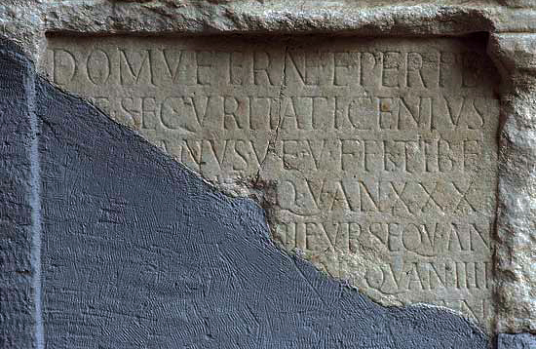
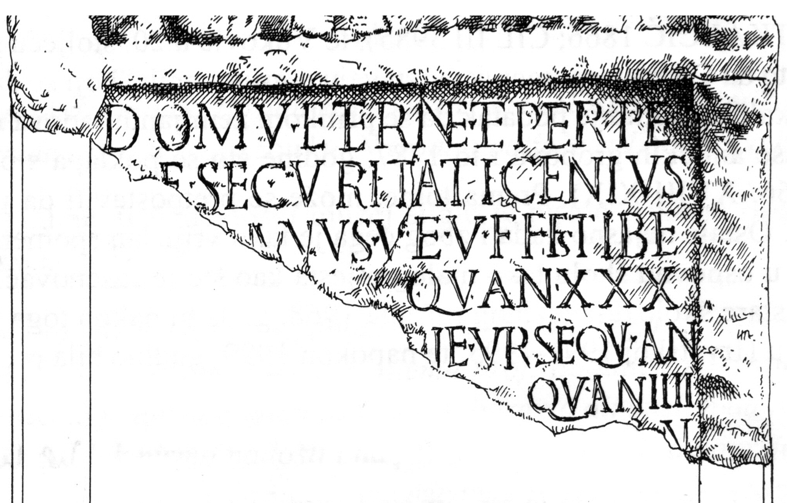
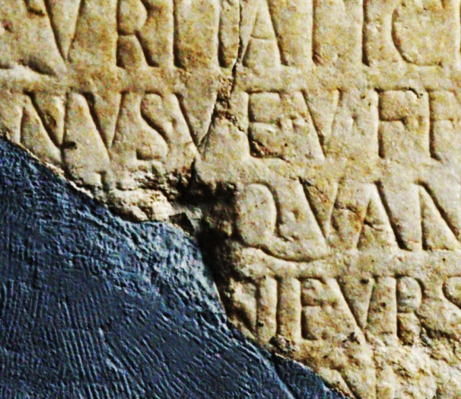
R I A N I C O
?????
RIANO•VE •
V I I I I • CEN
Tibe- Tiberianicus, Tiberianus, Tiberinus, Tiberius, Tibeurnus
Tibe/rino or Tibe/riano v(iro) e(gregio)

Slide 7
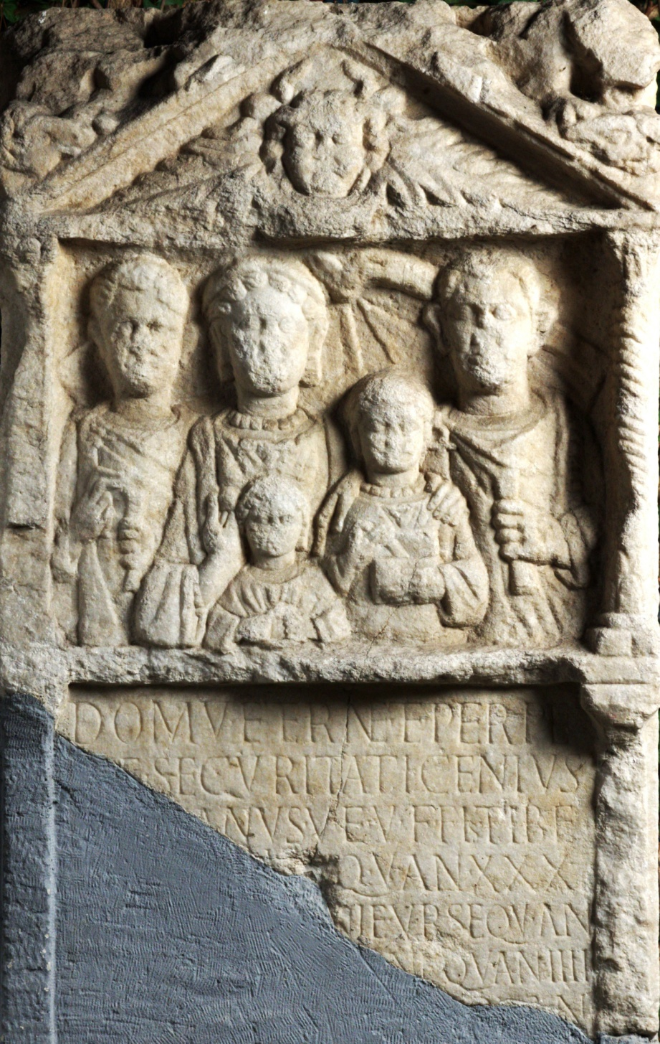
1
2
3
4
X X X ……….
5
6
F L●C A M P A N I L L E●QV●
7
8
Ursa: XXXII – XXXVI …..
Antoniana, Calendiola, Felicissima …

Slide 8
Was Caenius meant to be buried
in the Flavii family’s grave?
If not, why was he depicted in the
family portrait?
V(ivus) F(ecit) vs. V(ivus) F(ecit) S(ibi)
V(ivus) F(ecit) vs. F(ieri) I(ussit)

Slide 9
THANK YOU FOR YOUR ATTENTION!

